Slide 1

The WHERE assignment
By Nova 901
Citizenship Grade 9

Slide 2
Table of contents:
3 ……………………………………………………………. Personal
5 ……………………………………………………………. Community
7 ……………………………………………………………. Global
10 …………………………………………………………... Aspirational
12 …………………………………………………………… Song
-2-

Slide 3
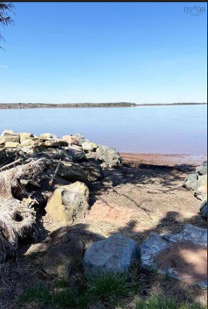
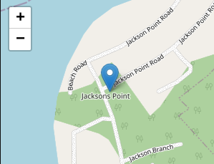
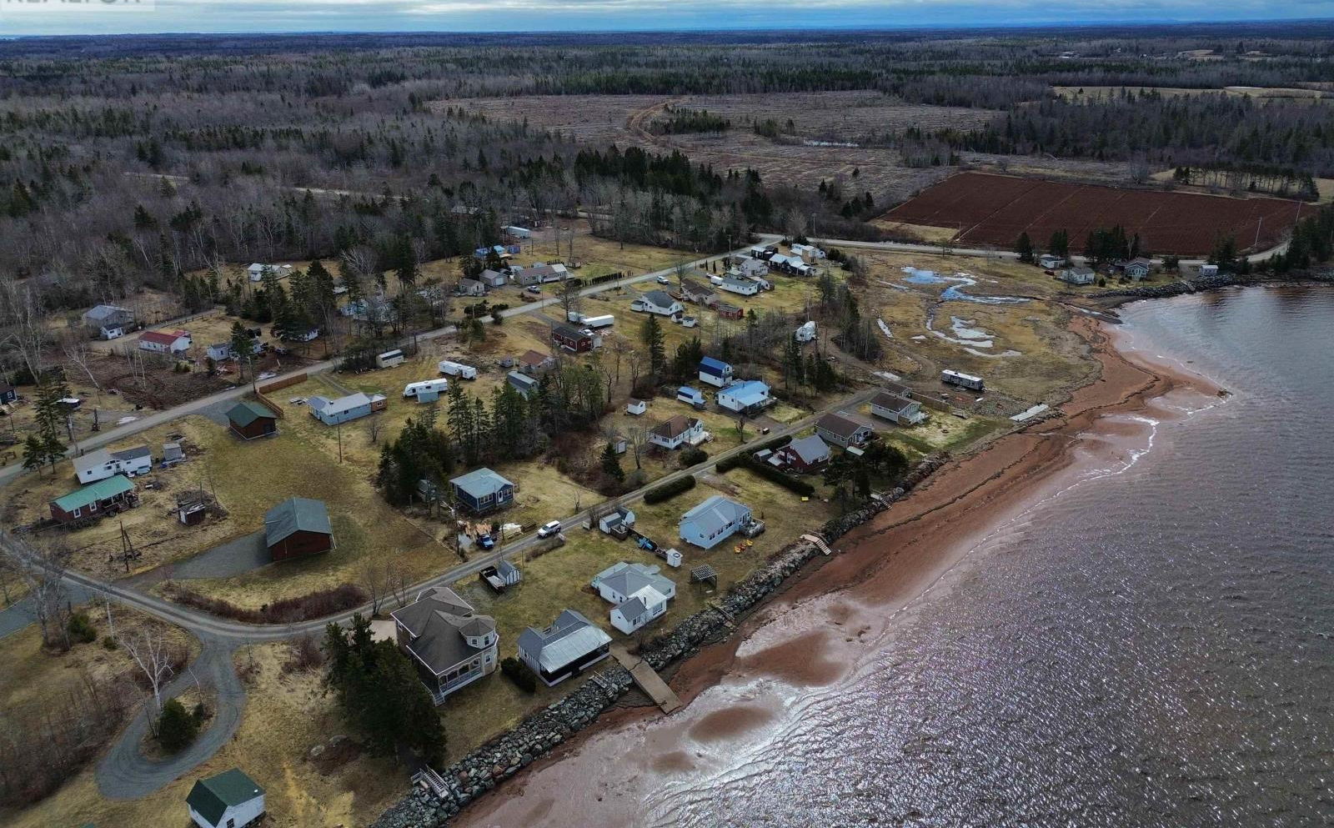
Personal ( 66 Jacksons point, Tidnish NS, My family cottage )
-3-

Slide 4
Personal
I have been going to my cottage for as long as I can remember. My father's parents used to own it and we would go up with them, at that time the cottage wasn't really all that nice, with vinyl floors and a rotting deck. My grandparents have since passed, my dad inherited the property, my family has put a lot of work into making a nice summer oasis. Every year we go up for two months in the summer, it's basically my second home. ( That is a picture of our beach, across the water is New Brunswick )I have been going to my cottage for as long as I can remember. My father's parents used to own it and we would go up with them, at that time the cottage wasn't really all that nice, with vinyl floors and a rotting deck. My grandparents have since passed, my dad inherited the property, my family has put a lot of work into making a nice summer oasis. Every year we go up for two months in the summer, it's basically my second home. ( That is a picture of our beach, across the water is New Brunswick )
-4-

Slide 5
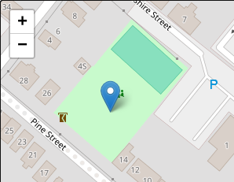
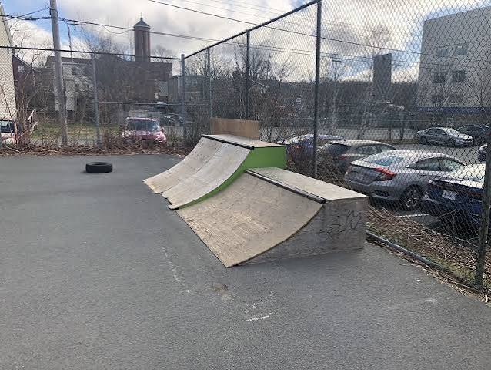
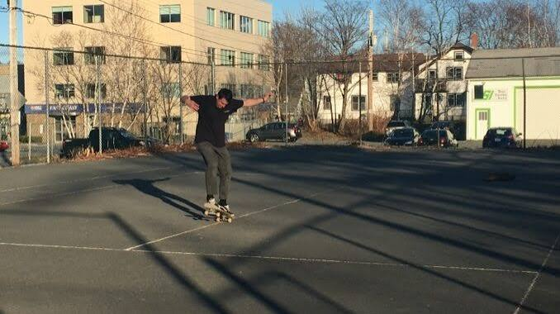
2. Community
-5-

Slide 6
2. Community ( Pine st. playground, Dartmouth NS )
Pine street playground, a place I would go almost every week. I live on Maple St. and have lived there my whole life. My sisters and I would go down to the playground with our scooters, but we didn't stop there, at the back of the playground is caged in tennis court, though it was never used as a tennis court. People in my neighbourhood used it as a mini skate park. Me and my sisters would scoot around and try to go up the wooden ramps people had brought. There is one very specific memory of Pine st. playground, it's encapsulated in a photo. The photo is of my dad pushing me on one of the swings, I just remember feeling like I was flying, because of how high my dad was pushing the swing. In the photo I have the biggest smile on my face, that memory is really special to me.
-6-

Slide 7
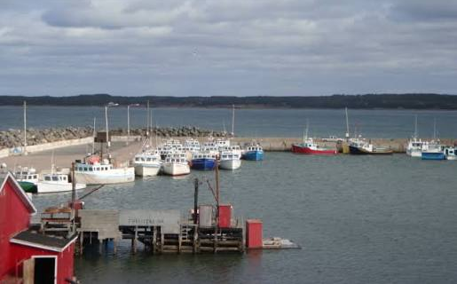
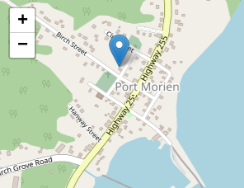
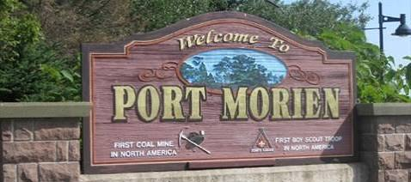
3. Global/Heritage ( Port Morien, CB/NS )
-7-

Slide 8
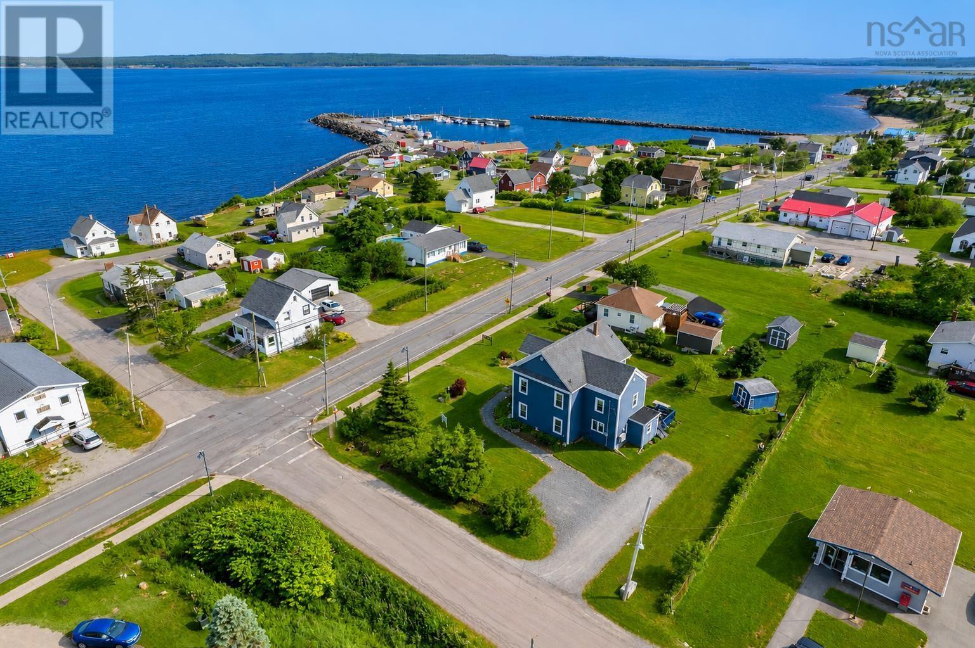
3. Global/Heritage ( Port Morien, CB/NS )
My Grampies childhood house
The piece of land we own
-8-

Slide 9
3. Global/Heritage
Port Morien is a tiny fishing town in cape Breton. It is also where my Grandfather and his two sisters grew up. I didn't know my grandfather too well because he passed away when I was two, but when I go up to Port Morien it makes me feel close to him. My dad tells me about the store my great-grandfather owned ( everyone in the family just calls it grandfathers store) he would tell me about going up to visit his grandparents and about all the crazy shenanigans my grandfather would get up to when he was a kid. I love going down the old and going down to the pier to look at all the fishing boats with the wacky names. My great aunt used to own the old house that they all grew up in, but they sold it in 2009 - 2010. We own a tiny plot of land there that my grandfather had bought long ago, its too small to do anything with, but it's nice to know we have some time the place. I love going there because it makes me feel close to my grampie.
-9-

Slide 10
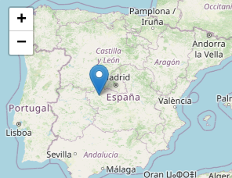

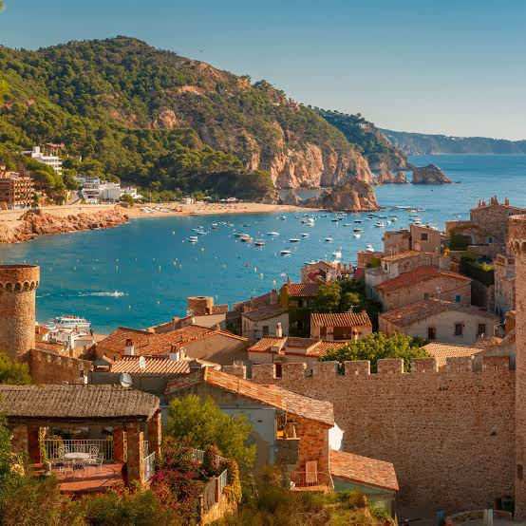
4. Aspirational place ( Spain )
-10-

Slide 11
4. Aspirational place
Spain has been a bucket list trip I've had almost all my life. The idea of lying on foreign beaches with hot sand between my toes is just so appealing to me. The food there sounds amazing, the culture and language is fascinating. I would love to go with my family, we always go on a vacation once or twice a year, usually on March break. This year we went to Italy, last year was France and the year before that was Mexico. Next year I was hoping to go back to Europe and perhaps Spain, but instead we are going to a small island in South America called Curacao. (The snorkeling is supposed to be great!) Someday though I would love to go.
-11-

Slide 12
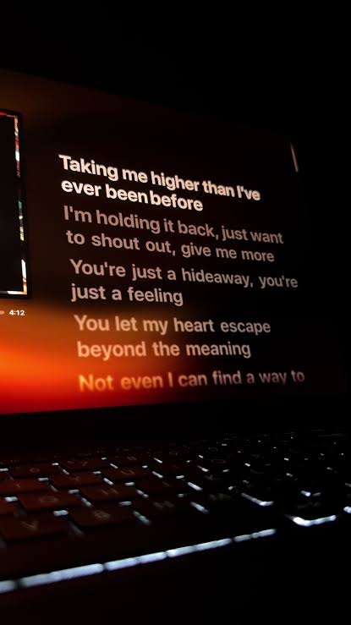
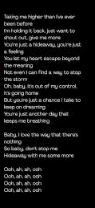

5. Nostalgic song ( Hideaway, by Kiesza )
-12-

Slide 13
5. Nostalgic song
This song has always been nostalgic to me, my older sister would always sing and dance to it. It was her favourite song. I will always remember my sisters and I dancing in the kitchen with diapers on our head to this song. My parents would play this song in the car, in the house, anywhere! Everytime I hear it, it brings me back to simpler times. It might have been the first song I ever knew all the lyrics to, other than twinkle twinkle little star and happy birthday. This song reminds me of home and my family. There will always be a special place in my heart for this song, and for the memories that go with it.
Song link = https://www.youtube.com/watch?v=vfrpvhVNXms
-13-

